Slide 1

VIRTUAL HAND GESTURE CONTROLLER FOR HOME AUTOMATION
Guided By
By K.M.Mahendran (111513107045)
Dr.G. Nalina Shini A.Naga Phanindra (111513107005)
I.Dinesh (111513107027)
Bharathwaj Chennuru (111513107014)

Slide 2
ABSTRACT
The disabled people may find it hard to use these household devices, As they have to reach for it or ask others to help them.
Lets make them lead their life with our little support.
Lets just sit back and control everything with hand gestures and make our day carefree.
Want to know how?
Handmote, a hand gesture recognition system for home automation which is helpful for physically challenged and blind people.

Slide 3
INTRODUCTION
We can automate our home to act on hand gestures to make life better.
Each hand gesture stimulate a toggle for each home appliance, that they can be controlled from a distance.
A raspberry pi(mini computer) is used for computer vision.
A raspberry pi camera can be used to recognize the hand gestures and the captured image is sent for image processing to a raspberry pi.
The RF trans receiver module is used to toggle the electronic gadget.

Slide 4
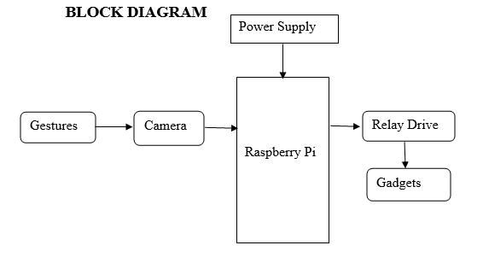

Slide 5
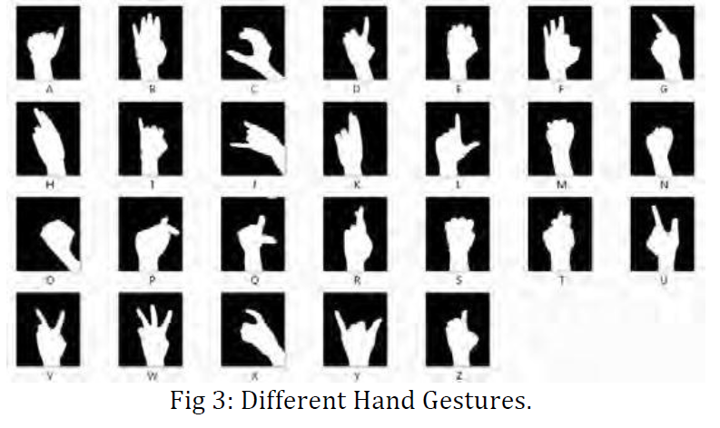

Slide 6
ALGORITHM
The algorithm used for hand gesture detection is Continuously adaptive mean shift (CAMSHIFT) algorithm.
Edge detection is the most common approach for detecting meaningful discontinuities.
An edge is a set of connected pixels that lie on the boundary between two regions.
The cany algorithm removes speckle noise in the image with a low pass filter and then applies sobel filter for better gradient magnitude.
The edges in gray scale image is counted(i.e. the number of fingers edges counted).

Slide 7
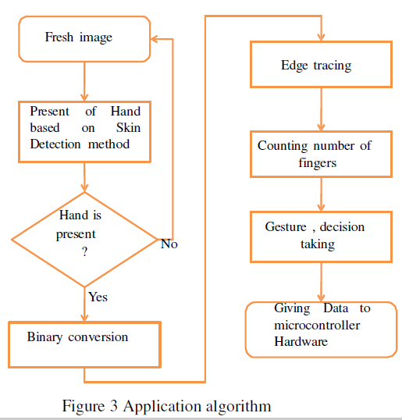

Slide 8
IMPLEMENTATION
A Raspberry camera which is interfaced to the CSI port of pi can recognize the hand gestures.
A web cam can also be used interfaced to the pi through the USB port.
The image captured would be digitized by sampling of the image and quantization of the sampled images.
The images are processed after converting them to bits of information.
The processing includes Image enhancement, Image restoration, and Image compression.
Each hand gesture specify each control of home appliances.

Slide 9
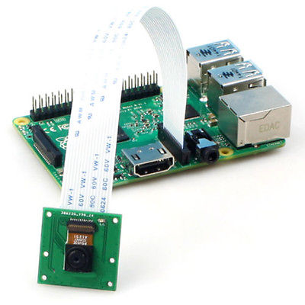

Slide 10
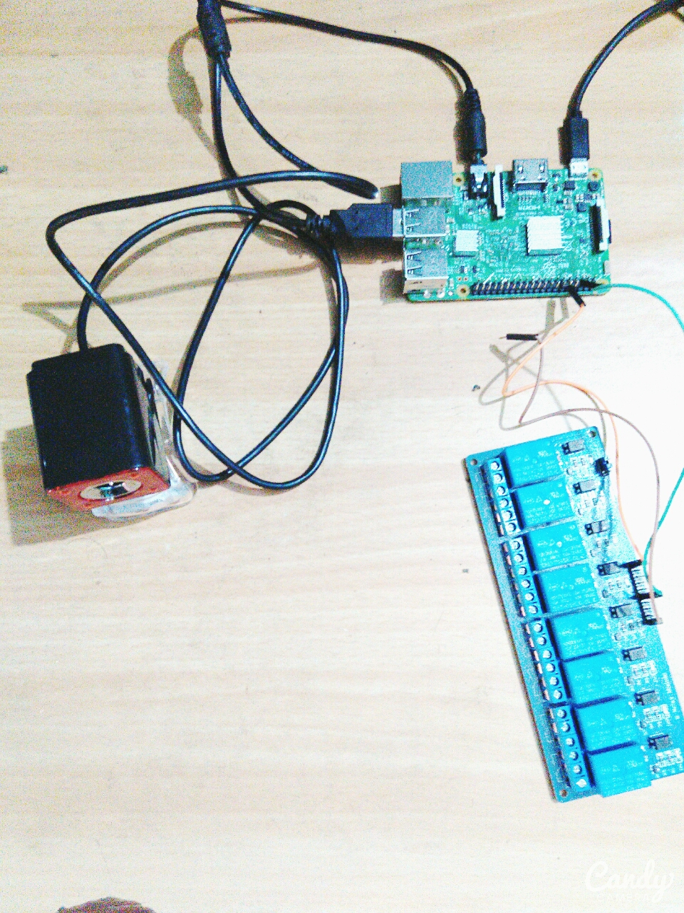

Slide 11
The hand gesture is detected to capture the fresh image and based on the algorithm, the image is checked and converted to binary digits.
The bits or pixels of the image are processed on edge tracing algorithm.
The gradient magnitude helps to find the edges of the fingers and count the number of fingers gestured.
Hand gestures are checked and its contributed device will be toggled.
The data is sent to a raspberry pi to stimulate its specific device by either wired or wireless transmission.
An RF signal can toggle a device on wireless basis and for wired transmission, a relay can be used to interface the device.

Slide 12
The number of fingers counted is recognized and raspbian is used to do computer vision.
The wireless transmission of data can be performed with HC-05/zigbee/ESP8266….
A relay is used with RF receiver module to toggle our device.
Each gesture toggles a specific device and can be controlled from anywhere else.
The physically challenged people can wave gesture to control each appliance in their house.

Slide 13
COMPONENTS
HARDWARE COMPONENTS:
Arduino uno R3/Nano.
Raspberry pi 3.
Raspcam/webcam.
Micro SD card Reader.
RF module/HC-05 module.
Relay Module.
Home Gadgets.

Slide 14
COMPONENTS
SOFTWARE:
Arduino IDE.
Raspbian OS-Jessie.
Python.
Open CV: The Open CV library software package supports many functions whose performance can be significantly enhanced on the Intel architecture, particularly the Open CV library is a collection of low-overhead, high performance operations performed on images. Computer Vision is done with Open CV with some Programming language.

Slide 15
ADVANTAGES
It consumes low power.
It is handy.
Low cost.
It requires small space.
Device can be controlled more comfortably .

Slide 16
APPLICATIONS
It can be used by military and social applications.
It can be used to play simple video games.
It can be used to control various home appliances.
It can be used in home theatre system where short distance communication is required.
Suitable for physically challenged people to operate the devices within room.
Gesture controlled robots and robotic arm.
Gesture recognition Encryption for Authorization.

Slide 17
CONCLUSION
The objective of this project is to develop such a system which will help physically impaired to control home appliances by hand gestures using accelerometer.
This provides comfort and convenience for common as well, especially in home theatre.
This technology is also used for home automation for physically impaired.

Slide 18
REFERENCE
Chao Hy Xiang Wang, Mrinal K. Mandal, Max Meng, and Donglin Li, “Efficient Face and Gesture Recognition Techniques for Robot Control”, CCECE, 1757-1762, 2003.
Asanterabi Malima, Erol Ozgur, and Mujdat Cetin, “A Fast Algorithm for Vision-Based Hand Gesture Recognition for Robot Control”, IEEE International Conference on Computer Vision, 2006.
Thomas G. Zimmerman, Jaron Lanier, Chuck Blanchard, Steve Bryson and Young Harvill, “A Hand Gesture Interface Device”, 189-192, 1987.
Jagdish Lal Raheja, Radhey Shyam, Umesh Kumar and P Bhanu Prasad, “Real-Time Robotic Hand Control using Hand Gestures”, Second International Conference on Machine Learning and Computing, 2010.
Gesture Controlled Robot using Kinect http://www.e-yantra.org/home/projects-wiki/item/180-gesture-controlled-robot-using-firebirdv-and-kinect
OpenCV Library http://docs.opencv.org/

Slide 19
THANK YOU

